Slide 1
The Basics of java
By daniel and ethan

Slide 2

Agenda
- What is Programming and Java?
Printing
Variables
User Input
Methods
Calculator Challenge

Slide 3

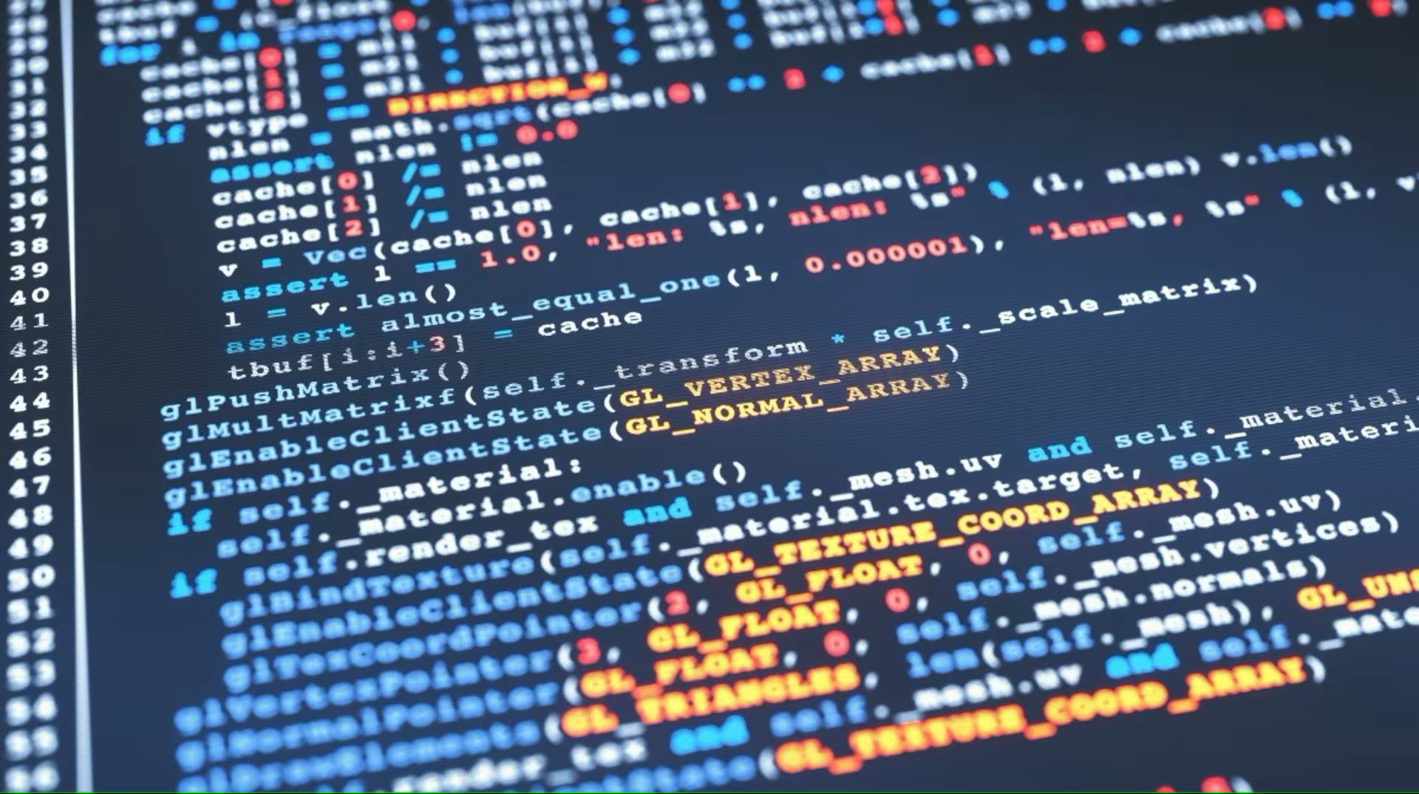
How does programming work?
The process of writing computer programs
Instruct the computer to execute in a specific way
Computers read the code step-by-step and display output

Slide 4
What is java?
High-level programming language made in 1995
“Write once, run anywhere”
Commonly found in many essential computing resources
Gaming
Web applications
Artificial Intelligence

Slide 5
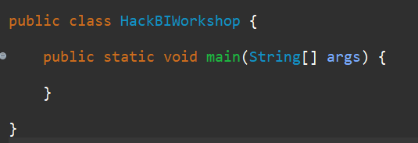
Let’s start programming!
Make sure you have VS Code installed.
Follow the instructions on the link here: https://code.visualstudio.com/docs/java/java-tutorial
Install the Java Platform Extension
Let’s make a quick test program!
Run the program (nothing should run, we are just ensuring there are no issues).

Slide 6
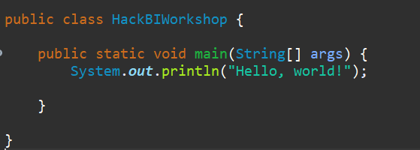
PrintinG
System.out.print(“ ”);
Does not make advance to a new line
System.out.println(“ “);
Advances text to a new line after printing
Semicolons at the end of your lines are important!!!!
Try printing your name!

Slide 7
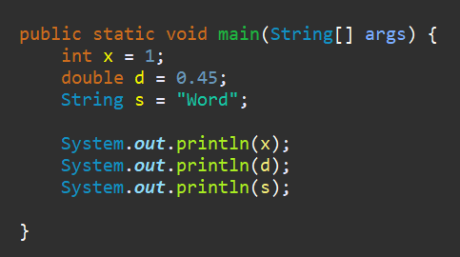
variables
Variables hold values
They have a datatype and a name as well.
(datatype) (name) = (value);
int - integer datatype
double – decimal datatype
String – “characters”
boolean – true or false
Values can be printed by name
Try it!

Slide 8
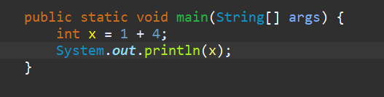
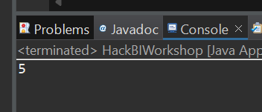
Variables (cont.)
You can also equate variables to mathematical expressions
int x = 1 + 4; (x = 5)
You can do PEMDAS to do more advanced calculations

Slide 9
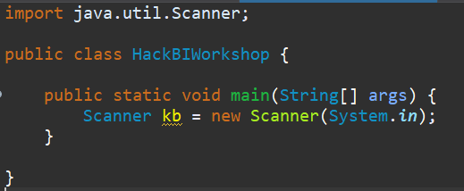
User input (scanner)
Scanners allow users to enter input to the terminal
Program can read the input and do something with it
Must import the Scanner class!
Make a Scanner variable (object) – can be inside or outside the main method

Slide 10
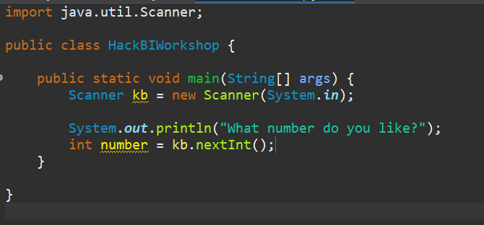
User input (cont.)
User input can be read in through methods
Equate a new variable to the following methods:
(objectname).nextInt();
(objectname).nextDouble();
(objectname).next();
Try some examples!

Slide 11
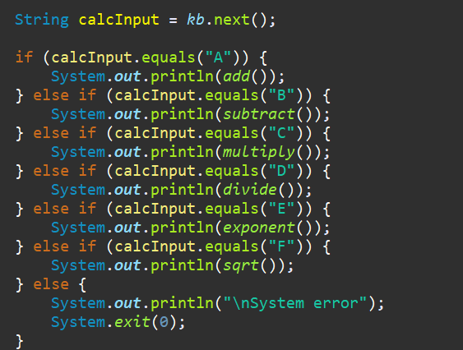
conditionals
Determine what to do in specific conditions
if (condition) { } else if (condition) { } else { }

Slide 12
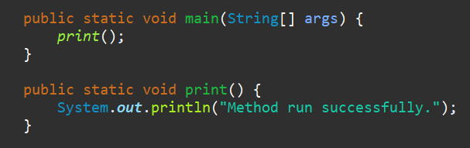
methods
Block of code that performs specific actions when called
Start with “public static” for today
Many more header options!
Needs a return-type
A datatype of the variable the method returns (can be void)
Must be surrounded by curly braces!
Run in main method
[methodname]();

Slide 13
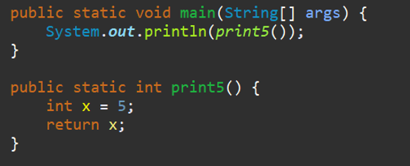
methods (cont.)
Methods that return a value need the return-value in the method header
Must end the function with the return keyword
You can print the method’s return-value

Slide 14
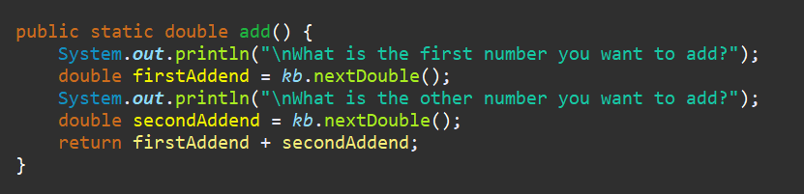
Calculator challenge!
With the things you have learned, plus the math methods sheet provided, try and make a calculator!
Hint: Ask the user what function they want to do, then use a conditional statement to perform a specific operation with user-provided numbers.

Slide 15
THANK YOU
We hope you took something out of this workshop!!!

